Slide 1

Yocto brief
Based on yocto-1.3
Yuanzhe Liu
Dec, 2012
Notes:
11/07/12

Slide 2
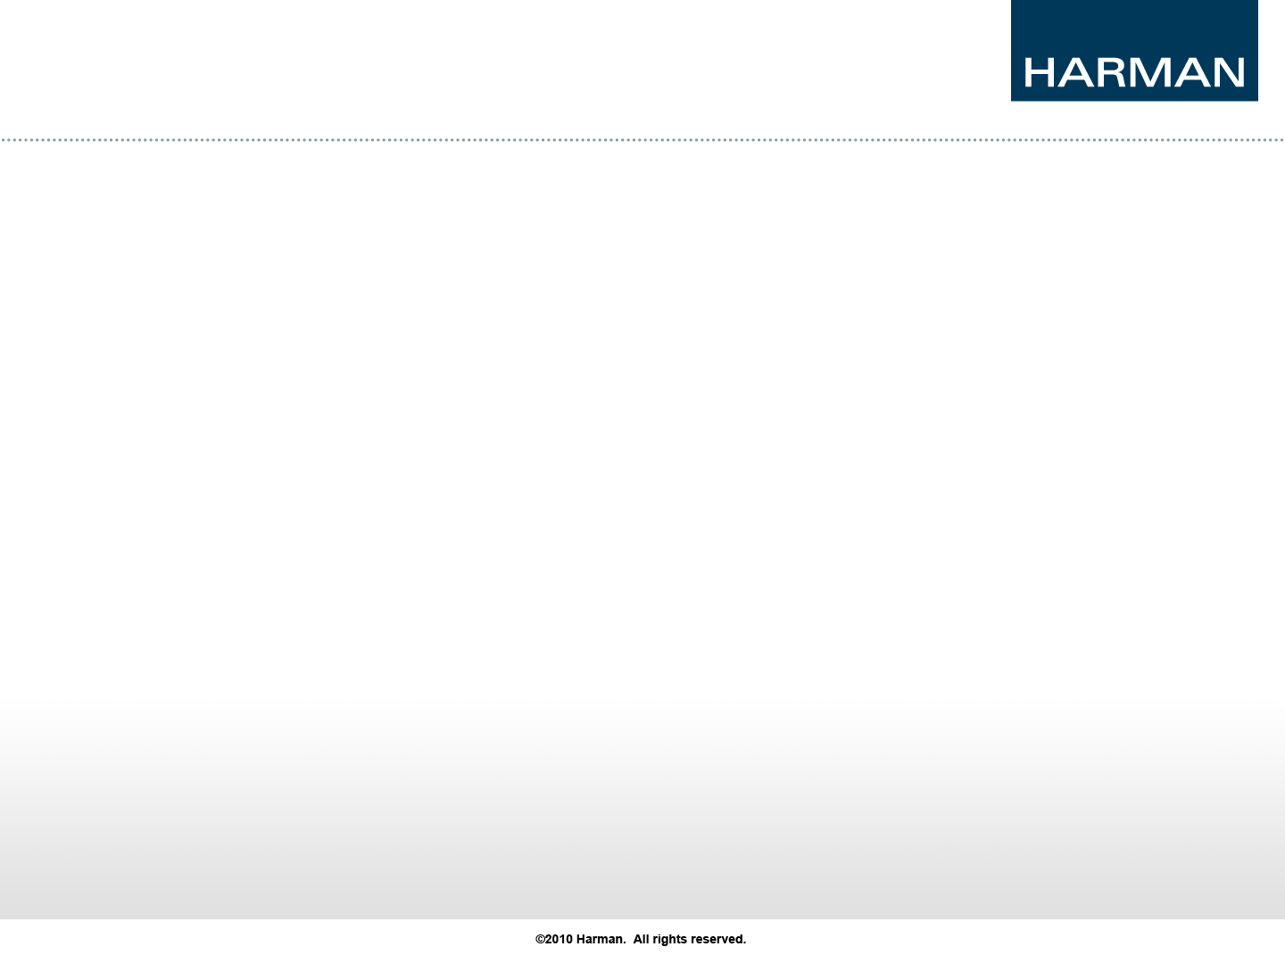
Agenda
About Yocto
Get start
Create a layer
Customze image
Appendix
Notes:
11/07/12

Slide 3
1. About Yocto
What’s yocto?
The Yocto Project provides open source, high-quality infrastructure and tools to help developers create their own custom Linux distributions for any hardware architecture and across multiple market segments.
What’s benefit of yocto?
The Yocto Project solves re-use problems by providing a single focus for embedded development, requiring less time to get a working and up-to-date distribution together.
What is the difference between OpenEmbedded and the Yocto?
What is the difference between OpenEmbedded and the Yocto Project?

Slide 4
2. Get start
Get source code
Access https://www.yoctoproject.org/download/yocto-project-13-poky-80
Download “Yocto Project 1.3 - Poky 8.0”
Run first build, for example core-image-minimal
$tar xvf poky-danny-8.0.tar.bz2 -C $(yocto_dir)
$cd $(yocto_dir)
$source oe-init-build-env
$bitbake core-image-minimal
After several hours, you can get image in $(yocto_dir) build/tmp/deploy/images

Slide 5
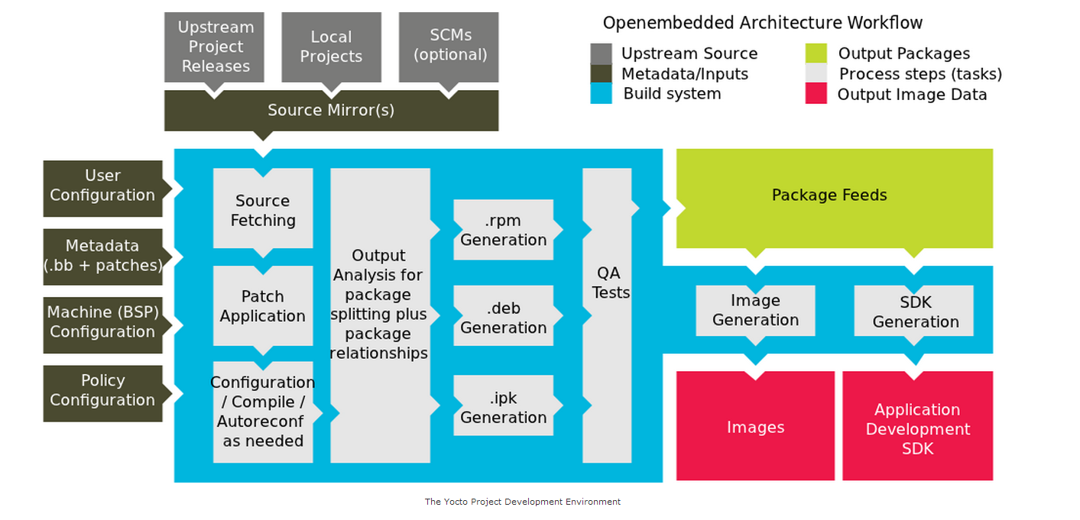
2. Get start

Slide 6
3. Create a layer
What’s layer
Folders that are layers begin with the string meta. such as meta, meta-hob, meta-skeleton, meta-yocto, and meta-yocto-bsp
Create a layer
Your can refer to following to create a sample layer.
$cd $(yocto_dir)
$mkdir –p meta-elina/conf
Create layer.conf
$cp meta-yocto/conf/layer.conf meta-elina/conf
Then modify variable in layer.conf by yourself, such as BBFILE_COLLECTIONS.
BBFILE_COLLECTIONS += "elina"
BBFILE_PATTERN_elina := "^${LAYERDIR}/"
BBFILE_PRIORITY_elina = "5"

Slide 7
3. Create a layer
Enable your layer
step1.If you never run a build or cleanup your build directory, else jump to step2.
step2. If you have ever run a build, and your $(yocto_dir)/build/ directory is exist.
Add your layer to BBLAYERS in $(yocto_dir)/build/conf/bblayer.conf
BBLAYERS ?= " \
/home/yuliu/work/tool/yocto/1.3/original_release/poky-danny-8.0/meta \
/home/yuliu/work/tool/yocto/1.3/original_release/poky-danny-8.0/meta-yocto \
/home/yuliu/work/tool/yocto/1.3/original_release/poky-danny-8.0/meta-yocto-bsp \
/home/yuliu/work/tool/yocto/1.3/original_release/poky-danny-8.0/meta-elina \
"

Slide 8
4. Customze image
Create image dir
$mkdir –p $(yocto_dir)/meta-elina/recipes-core/image
$cd $(yocto_dir)/meta-elina/recipes-core/image
Create image-elina.bb file
$touch image-elina.bb
Modify variable IMAGE_INSTALL to add oss which you need. You also can user IMAGE_INSTALL +=“”.
image-elina.bb:
DESCRIPTION = "A sample image"
IMAGE_INSTALL = "busybox icu"
IMAGE_LINGUAS = " "
LICENSE = "MIT"
inherit core-image
IMAGE_ROOTFS_SIZE = "8192"
# remove not needed ipkg informations
ROOTFS_POSTPROCESS_COMMAND += "remove_packaging_data_files ; "

Slide 9
4. Customze image
Build image
$cd $(yocto_dir)
$source oe-init-build-env
$bitbake image-elina
Then you get image in $(yocto_dir)/build/tmp/deploy/images

Slide 10
5. Appendix
Yocto project websit:
https://www.yoctoproject.org/
Yocto development manual:
http://www.yoctoproject.org/docs/current/dev-manual/dev-manual.html#usingpoky-extend-addpkg
Yocto reference manual:
http://www.yoctoproject.org/docs/1.3/poky-ref-manual/poky-ref-manual.html#how-does-the-yocto-project-obtain-source-code-and-will-it-work-behind-my-firewall-or-proxy-server
Yocto quick start:
http://www.yoctoproject.org/docs/current/yocto-project-qs/yocto-project-qs.html

